Slide 1

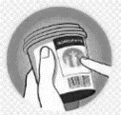












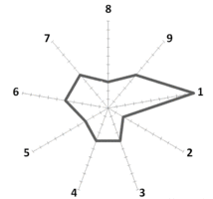



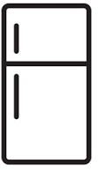













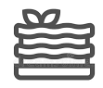

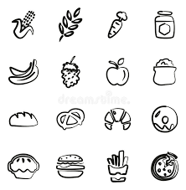

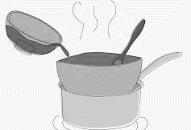












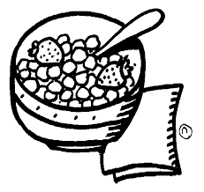

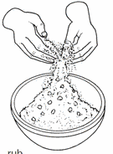














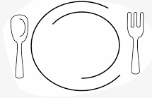


















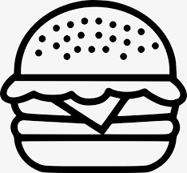
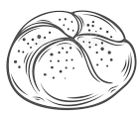






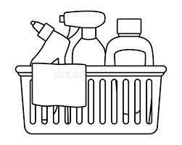

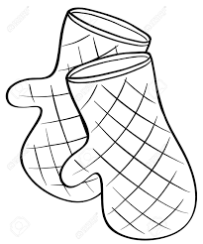
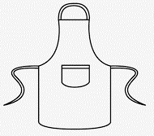


Food Curriculum Map
Food offers you a curriculum which will engage and enthuse a passion for the subject. Giving you the opportunity to explore practical activities which will enable you to master the skills and secure your knowledge.
Food provides the subject specific skills and knowledge as a platform for you to take your next steps, from KS3 to KS4, then onto a professional career within the Food industry or on to Further and Higher Education.
Year 7
Establish – Stretch – Challenge – Growth Mindset
Year 11
GCSE Food, Preparation and Nutrition will develop your skills and knowledge in working with a variety of Food Skills and techniques including: different cake methods, dough, vegetable preparation, working with raw meat, flavouring and sauce making. You will find out why the human body needs food and how it is used, where food comes from, how it is grown and produced, you will explore the science of food and learn how to create and present your own dishes .
Food Production & processing
Food Labelling
Sensory Evaluation
&
Testing
Past Paper Questions
Revision
Free Range
Food
Choice
Exam Content & Practice Questions
Exam & Post – 16
Destination
Organic
Food
Provenance
Food security
Climate Change
British
&
International cuisine
Factors
Exam Technique
Product testing and analysis
Skills Trials
Product analysis
Practical Experiments
Sustainability
Food
Provenance
Practical Assessment
YEAR
Food Storage
Environmental impact of food production
None Examined Assessment 2
(Produce dishes to meet the chosen brief)
Non Examined Assessment 1 (Science based research)
11
Evaluation
Product Specification
Food Poisoning
Research
Food Safety
Risk assessment
Photograph & analyse
Research
Analysis
Planning
International Cuisine
Planning
Vegetable Preparation
Enzymes
Forming & shaping
Sauce making & assembly
Pasta making
Double Boiler method
Skills trials
High Risk Foods
Batter & deep frying
Dough & raising agents
Caramel
Fatless sponge
Jointing a chicken
Practical Assessment
YEAR
10
Nutrition – Macro & Micro
Nutrition & Health
Food Science
NEA 2 Mock
Protein
Fats
Minerals
Cardiovascular Disease
Chemical properties
Research
evaluation
Bacteria
Eat Like An Athlete
Carbohydrates
Vitamins
Diet & Health
Cooking & Heat Transfer
Planning
R2 – Healthy Eating
Rubbing in method
Combining flavours
Rice
Combining flavours
Vegetable Preparation
Breakfast
Dough Making
Use of hob & oven
Working with raw chicken
Creaming Method
Pastry
Sauce making
Drinks
R1 – Food Choice
& Food and The environment
YEAR
Healthy Eating
Sustainable
Farming
6 R’s
Allergies & Intolerances
Seasonality
Cost of food
9
Fast food vs Exercise
Food Waste
Sustainable
Fishing
Food and the environment
Food availability
Food Choice
Vegetable preparation
Combining ingredients
Melting Method
Batter Making
Culture
Roux sauce
Combining flavours
Creaming Method
Coagulation
Use of hob & oven
Rubbing in method
Creaming method
Dextrinisation
YEAR
8
R1 – Food Provenance
R2 – Food Science
Shortening
Use of the hob
& oven
Food Miles
Fair Trade
Protein denaturation
Coagulation
Locally produced
Free Range
Heat transfer
Gelatinisation
Stir Fry
Melting sugar
Seasonality
Organic
Forming
& shaping
Kneading
Use of the hob
Handling raw meat
Introduction to knife skills
Use of hob & oven
Vegetable preparation
Creaming method
Use of the oven
YEAR
Pastry
R2 – The Eatwell Guide
R1 – Hygiene, Safety and Equipment
7
Fats & Sugars
Protein
Kitchen routines
Kitchen Safety
Equipment
Dairy
Fruit & Vegetables
Carbohydrates
Hygiene
Knife Safety
Nutrition • Provenance • Technique • Skill

