Slide 1
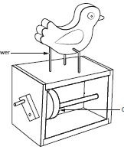


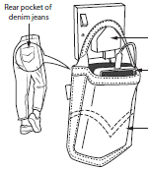
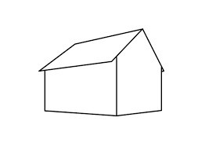

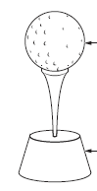
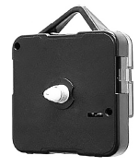
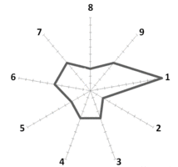
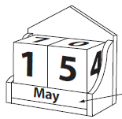
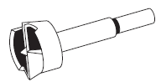
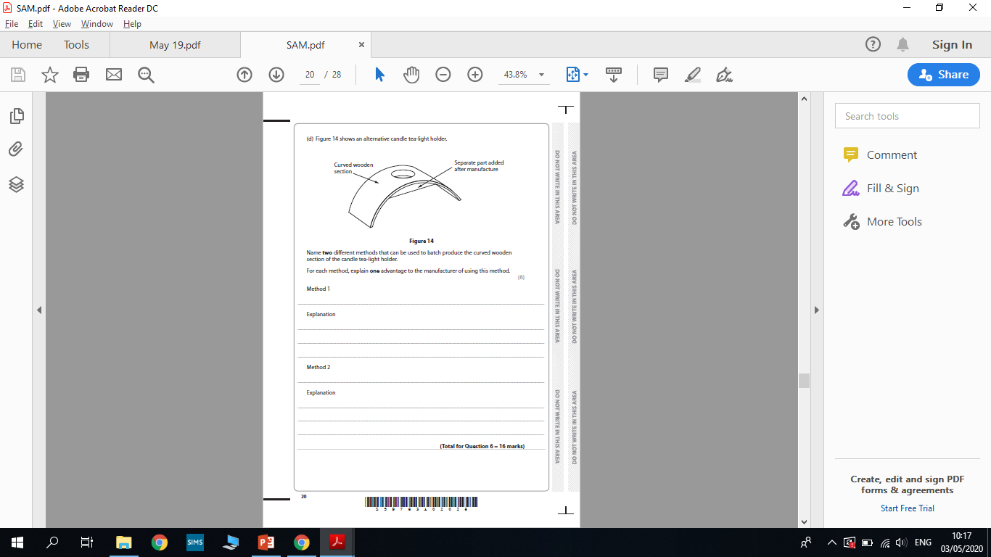









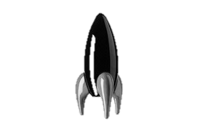
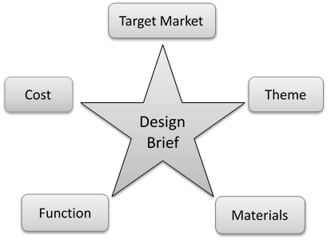





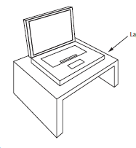
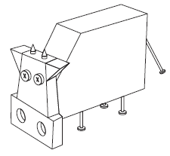

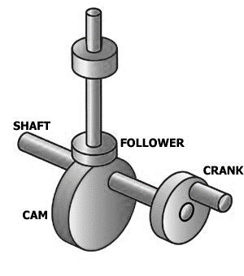
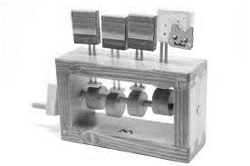
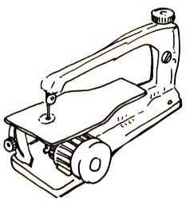





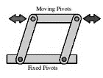
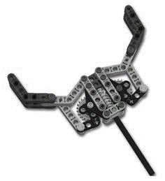



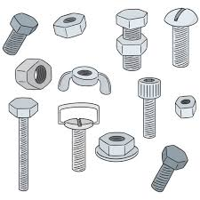

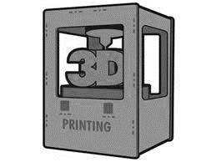






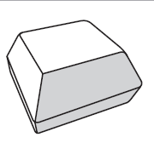
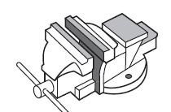








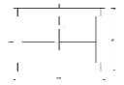






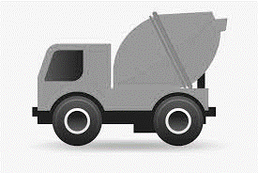


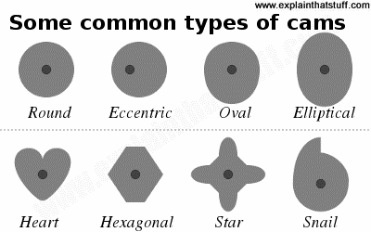






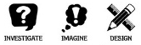
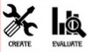

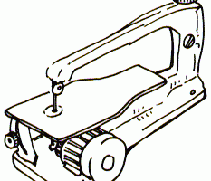




Design & Technology Curriculum Map
D&T offers you a curriculum which will engage and enthuse a passion for the subject. Giving you the opportunity to explore practical activities which will enable you to master the skills and secure your knowledge.
D&T provides the subject specific skills and knowledge as a platform for you to take your next steps, from KS3 to KS4, then onto a professional career within the Creative sector or further education.
Year 7
Established – Stretching – Challenged – Growth Mindset
Year 11
GCSE Design and Technology will develop your skills and knowledge in working with a variety of materials including: timber, polymers, metals textiles, electronics, paper and boards. You will explore iterative designed concepts, review a range of past designs and designers, develop your drawing skills and find out about new and emerging technologies such as Laser cutting, 3D printing and smart materials.
Mechanisms
Product modifications
Standard
Components
Timber properties and sources
Upcycling
2 Point
Perspective
Life Cycle Analysis
Non Examined Assessment
(Making and Evaluating)
Core Exam Content
Exam & Post – 16
Destination
Non
Examined
Assessment
(Designing)
Manufacture skills
Forming
Sustainability
Design Math
Product testing and analysis
Tools
Isometric
Drawing
Renewable Energy
Assembly
CAD design
Related product analysis
Design Brief
CAM
YEAR
Product Evaluation
None Examined Assessment
(Research)
11
Non Examined Assessment (Practise)
Product evaluation
Product Specification
Market Research
Product evaluation
Iterative Design
New and emerging technology.
Risk assessment
Design Ideas drawing
Research Analysis
Quality Assembly
Cams
Machine tools
Hand tools
Design modifications
YEAR
Accuracy of finish
Automata
Wasting techniques
10
Materials
Designing principles
Making principles
Timber
Properties
Marking out
Manufacture
Lego Mechanisms
Fixings
3D Printing
Design Brief
Types of Finish
Linkages
Star Diagram
EBI/WWW
Laser cutting
Graphic
finish
Energy Sources
Metal
bottle
opener
3D Printing
Design Brief
Shakespeare
Fixings
Living Hinge
Electronics
Flowchart
Planning
Craft knives
Design work
CAD / CAM
Set Design
YEAR
Paper and Card
9
Isometric
Drawing
Laser cutting
2D Design
Contours
Presenting
Model making
Metals
SolidWorks
Product
Evaluation
Life cycle
analysis
Publisher
Design Brief
Drawing
Marking out
PPE
Isometric
Drawing
Design
Sustainable
Farming
Sketch
drawing
Electronics
Flowchart
Planning
Life cycle
analysis
Sustainable
Fish
CAD
YEAR
Design Brief
2D Design
8
Flashing lights project
Pebble project
Sustainability
Catering
Specification
Risk
Assessment
Marking out
Star Diagram
EBI/WWW
The Forest
Stewardship
Council
Renewable
Energy
Industry
Lap Joint
Product
Evaluation
Lap joint
Composites
The 6 R’s
Construction
Manufacturing
Cams
Biomimicry
Design
Design Brief & Specification
Design Process
P.R.I.M.E.
Mechanisms
Isometric
Drawing
Marking out
Fixtures
Automata
Graphic
finish
Mood Boards
Health and safety
Surface Finish
YEAR
Motion
Isometric and
Oblique drawing
Phone Holder
Finger Joint Box
7
2D Design
Contours
Research
Metal work
Laser Cutter
2D Design
Contours
Star Diagram
Fret Saw
Pillar Drill
Timbers
Finger joint
Design • Knowledge • Manufacture • Evaluate

