Slide 1



















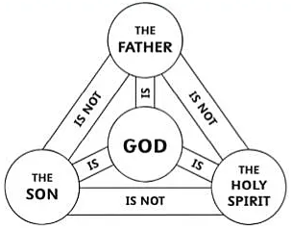
Religious Studies – KS3 journey
Animal rights
Eve and original sin
Incarnation
Resurrection
Ten Commandments
New Testament
Trinity
Crucifixion
Shariah Law
Changing world
Matriarchs of the Bible
Christian Beliefs and teachings
Situation ethics
Mary Mother of Jesus
Nature of God
Religious Law
Stewardship/
dominion
Book of Esther
Salvation
Unjust laws
Mystical experience
Near Death Experience
Year 9
Transcendence and Immanence
Vandana Shiva
Rebels: should we embrace or challenge
Knowing God
Bonhoeffer and pacifism
Martin Luther and Sola Fide
Atman
St Bernadette
Sufism
Job and suffering
Suffering
Ethics, Philosophy, Agape.
Jesus's
Anthropology
Inconsistent triad
Equality in Sikhism
Year 8
Dhamma
Moksha
Social Justice
Ethics: what is good?
Jesus
Buddhism
Dharma
Sewa
Ancient & modern philosophers
Abrahamic Faiths
Sangha
Sanatana dharma
Sikh Dhamma
Christianity
Buddhist Dhamma
Muhammad
PBUH
The New Covenant
Abraham
Philosophy
Pluralism
Trinity
Isaac and Ismail
Aristotle
Plato
The diverse Christian Church
Year 7
Anglicans Methodist
Prophethood
Covenants
Worldviews.
Quakers
Predestination
Moses
Promised Lands
Abram
Hare
Pope
Father of many nations
Jehovah Witness beliefs.
David
Adam
Worldviews introduction

