Slide 1


Options Evening 2026
The Bishop of Hereford’s Bluecoat School
Mr Collingbourne

Slide 2
Welcome – Mr Williams - Headteacher
Emergency fire procedures
On hearing the fire alarm (which sounds like a continuous 2 tone siren) - leave the building immediately via the nearest exit
All visitors and staff to vacate to the front of the building and proceed to the far left hand corner of the carpark – (when you have your back to the main building of the school) This is marked as the fire assembly point.
All staff and visitors to remain outside until informed that it is safe to return to the building. Further instructions will be provided by the Fire Service or Designated Fire Officer at the school.

Slide 3
GCSE choices
This is the NOT the most important decision you will make in your life.
However, the choices you make will play a large part in your chosen career.

Slide 4
Our INTENT
Provide a curriculum with breadth and opportunities for all.
We believe in offering as much choice as we can.
GCSE’s, Cambridge National, Level 1and 2 courses.
Ebacc. – Grade 5 in English, Maths, Science x2, a Language, History or Geography.

Slide 5
EBACC – Recognised by many Universities and employers as a more academic route.
English - X
Maths - X
Science - X
History or Geography
Language

Slide 6
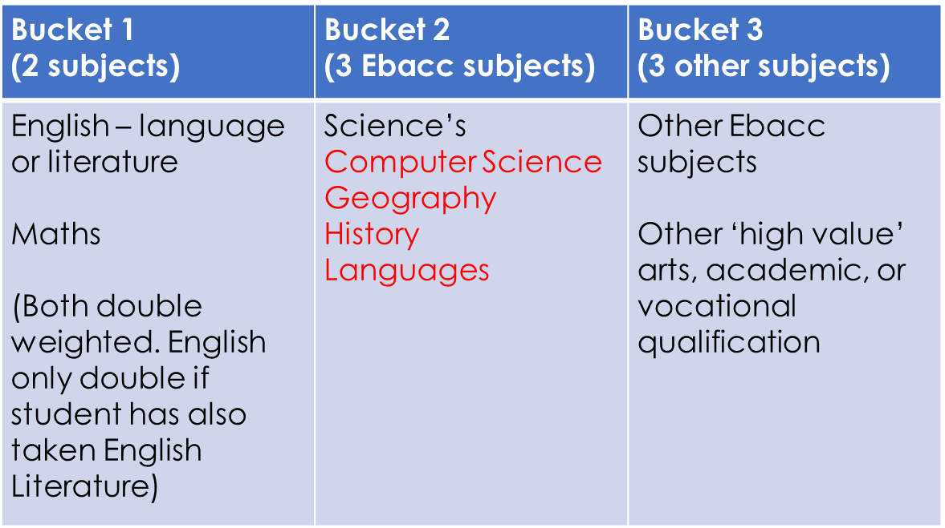
Subjects in A8/P8 measure

Slide 7
4 options = 9 GCSE’s
1 – English Language
2 – English Literature
3 – Maths
4 – Combined Science
5 – Combined Science
6 – Option 1
7 – Option 2
8 – Option 3
9 – Option 4
RS Short course -
½ a GCSE

Slide 8
Key Features of GCSE’s
Increase level of challenge and proper preparation for A Level or further study.
Focus on knowledge based curriculum.
Extended writing; fewer bite-sized questions.
No higher and foundation tier papers, except in Maths, Science and Languages.
Grading scale 9 - 1 and U

Slide 9
Who decides?
Students…
Parents/carers….
Teachers…..
Other staff …..
You have time to research and ask questions before committing to your choices.

Slide 10
Key Dates
Thursday 19th March – Consultation Evening
Friday 20th March –Options form opens on Sims Student App
Friday 27th March – Final deadline for options form to be completed using the app.

Slide 11
What’s new -
Options chosen in order of preference
Supportive pathways
Springboard, ASDAN, Arts award – 3 options instead of 4.
15 selected students based on academic profile and attitude to learning.

Slide 12
Instructions for the trial run:
Using the Student Sims app, students must choose 4 options in order of preference and a reserve.
Option A – favourite subject
Option B – second favourite
Option C – third favourite
Option D – fourth favourite
Reserve Option – fifth favourite
Students MUST select at least one from: Geography, History, Triple Science, Computer Science or a Language as part of their 4 choices.

Slide 13
Supportive pathways -
Group B - Based on the academic profile of your child, we would strongly recommend they consider opting for the some or all the following subjects.
Triple Science, French, Spanish (if studied in KS3) and Computing.

Slide 14
Supportive pathways -
Group HB - Based on the academic profile of your child, we would advise they only opt for the subjects below if they have a significant passion for these subjects and their teacher supports the request.
Triple Science and Computing.

Slide 15
Supportive pathways -
Group S - Based on the academic profile of your child, they can opt for the ASDAN and / or the Springboard pathway resulting in them doing one or two less GCSEs. Based on an induvial basis, these students will study some or all the following courses.
ASDAN, Arts Awards, Entry Level qualification and Springboard.

Slide 16
Other factors to consider
The importance of a good attendance.
90% attendance means your child misses one lesson a fortnight over the year.
This will have a significant impact on their GCSE grade but especially their NEA (coursework)
Year 9 report and EPT (target grade)

Slide 17
Other factors to consider -
Amount of NEA / coursework
Assessment schedule
Exam weighting

Slide 18
Other factors to consider -
COST –
Technology - a contribution to buying materials and paying for ingredients for Food.
Art - Kit and sketch book
Languages – all students will need to buy a dictionary and a grammar book.
TRIPS – In some subjects there are compulsory trips – e.g. in Drama you will have to go to the theatre and write about it. There is also an offsite visit in Geography and History. We do ask for a contribution.
EXTRA – CURRICULAR – In all subjects there will be clubs that will have an impact on their grades. Especially the NEA element of a course.

Slide 19
Big decision
After the 27th March these option choices are final.
1 – 1 meetings will confirm decisions.
Students will only be able to change if there is a safeguarding or medical reason.
Students will find out their option choices in June.

Slide 20
Tips for this evening
Speak to the relevant Heads of department this evening to get an overview of the course
Look at the assessment criteria for each course. Percentage of exam, NEA (coursework), how many exams.
This is a fact-finding evening. Individual conversations will take place at the Consultation Evening.
DO NOT – choose a subject based on your friends' choices.
DO NOT – choose a subject because you like the teacher.

Slide 21
Questions
Any questions about the process please email ocollingbourne@bhbs.hereford.sch.uk
Any subject specific questions please contact the Head of Department.
Student specific advice, please contact your form teacher, Head of House or Pastoral Mentor.

Slide 22
Subject | Venue
Religious Studies | Deli
Health and Social Care | Deli
Business Studies | Deli
Triple Science | Room 52
French | Room 7
Spanish | Room 7
PE | Hub 1
Computer Science | Room 51
Creative I Media | Room 51
Art | Room 56
Performing Arts | Drama Studio
Music | Drama Studio
Geography | Humanities atrium
History | Humanities atrium
All Design & Technology and Food subjects | Hub 2
For more information on ASDAN, Springboard and Arts award please see Mr Vaughan in the library.

